Slide 1
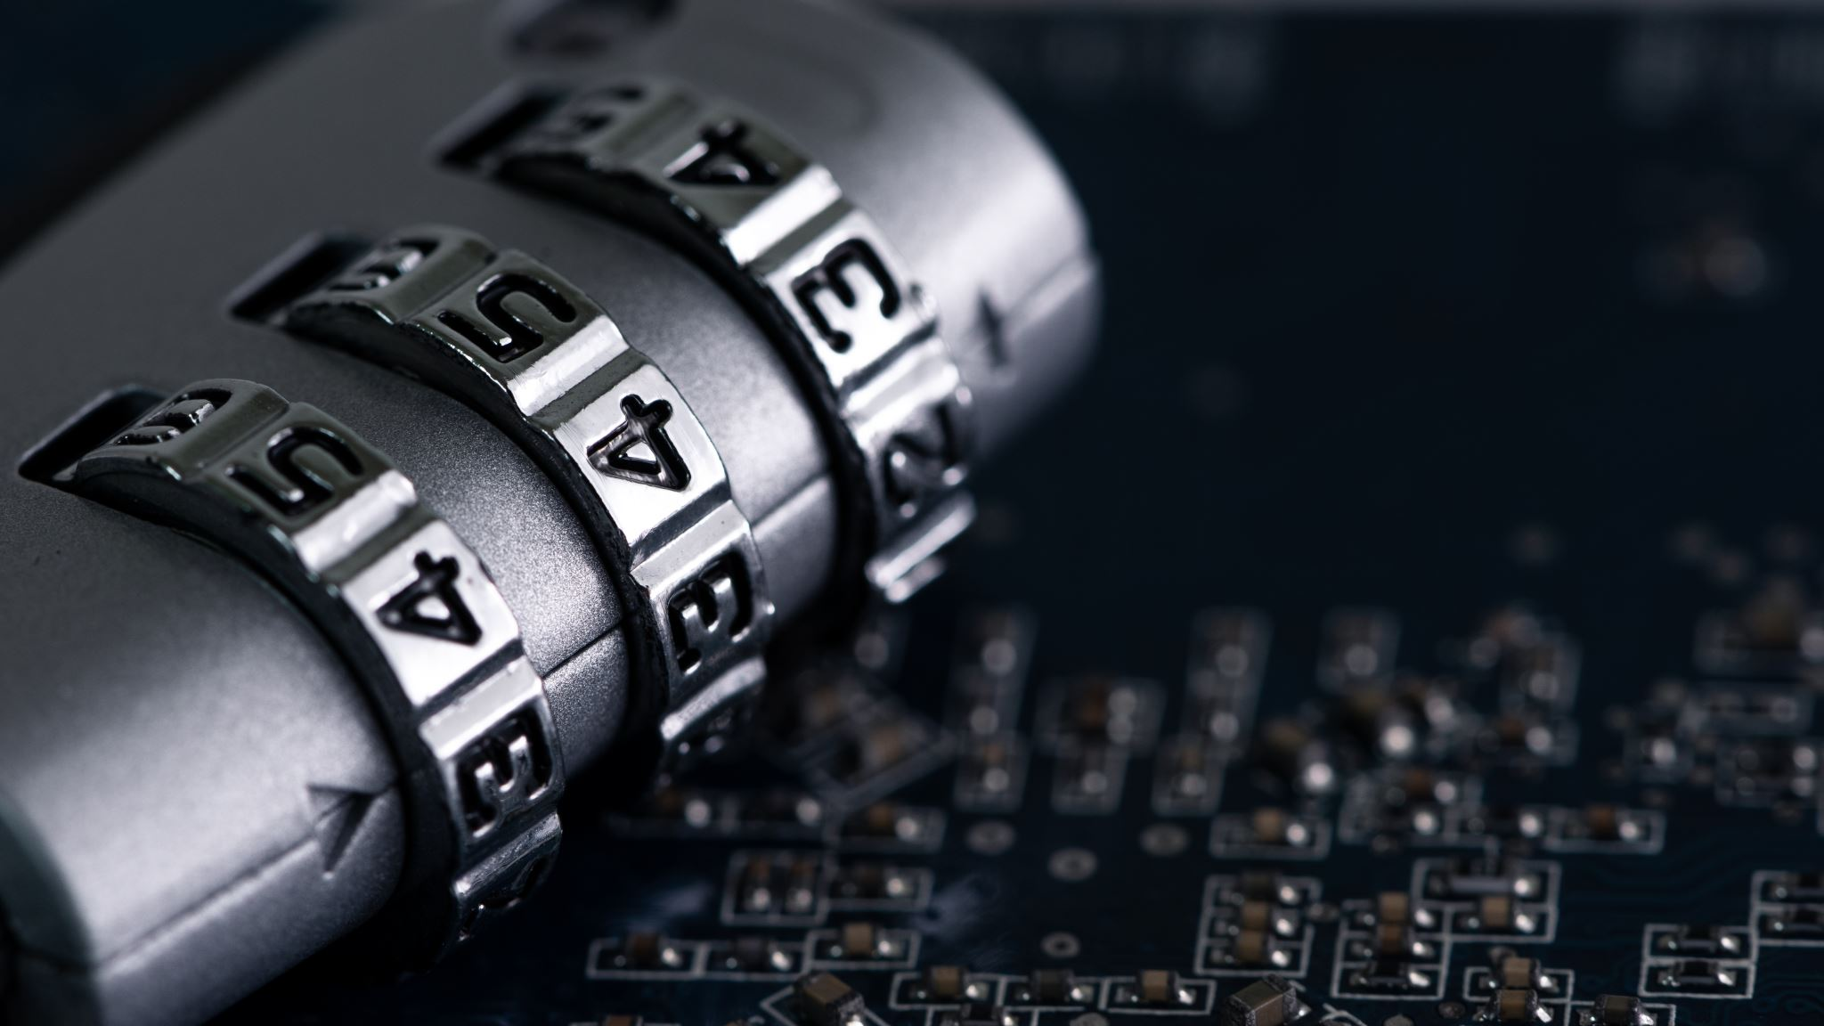
Offensive Cyber Operations in Context
Myriam Dunn Cavelty
BSides Zürich 9/9²³

Slide 2
Cyber Security Politics
Aims to understand and explain the relationship between
THREATs: the political/strategic use of digital technologies by state and non-state actors
RESPONSEs: the interactions between states, society, and the private sector to define roles, responsibilities, laws and norms for acceptable behaviour in Cyberspace

Slide 3
Technology constrains what can be achieved politically
Politics constrains what will be attempted technologically
…you can′t have one without the other

Slide 4
A Story of Interactions
Question: How and why did cyber-security become a security political issue in the 1990s?
Answer: Through a «securitization» process in which a (successful) political case for an urgent, existential problem was made
Process: Cyber incidents are linked to security political/ societal concepts and values
Problem: «National security» vs. «Human security»
No security political connotation is “natural”, but determined in political processes

Slide 5
Four Key Frames (1980-2000)
Not normally considered “National Security”!
Digital Crime
Frequent, low-level impact
Focus on vulnerability / dependency / economic value
Digital Espionage
Cases: Rome Lab, Solar Sunrise, Moonlight Maze, etc.
Clear link to national security: confidential information as target
Digital Warfighting
A positive frame:
Winning wars in the information age / information superiority, link to RMA
Digital Doom
The negative counter-frame:
Asymmetric Threat, Target Society / Critical Infrastructures
Four Key Frames (1980-2000)
The biggest mobilizer

Slide 6
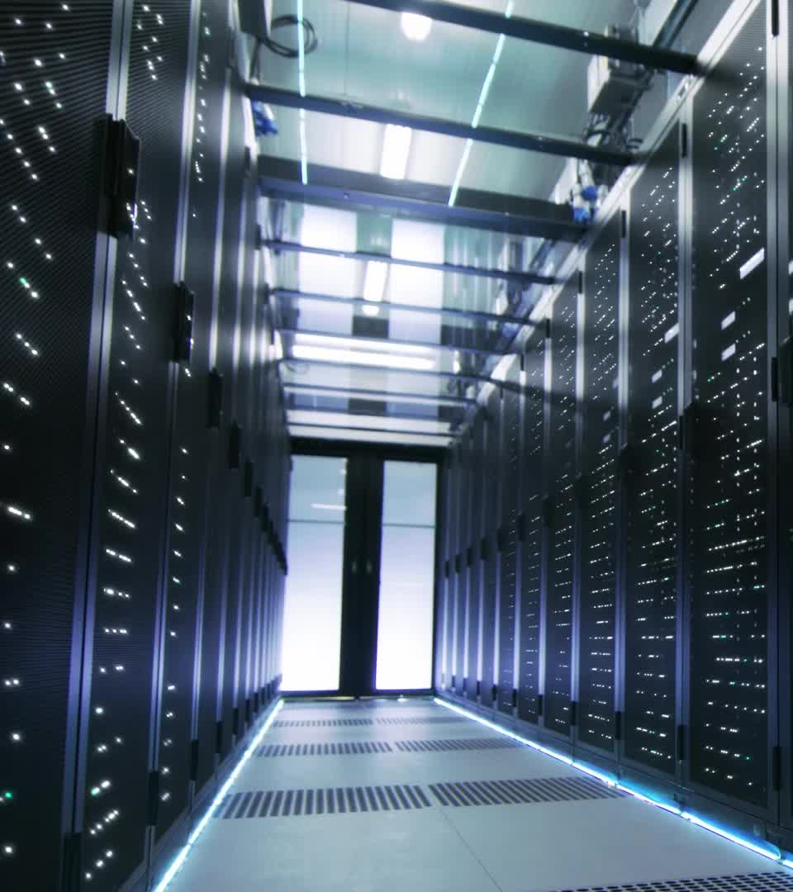
Reaction 1: 3-pronged defensive measures
A law enforcement pillar for countering cyber-crime
Private-public partnerships (voluntary) for critical infrastructure protection
Private and public self-help for the rest of the networked infrastructures
The owners of networks are primarily responsible for their protection
The government (and military) only protects its own network
Companies protect their networks
Every individual is responsible for their own computer security
Prevention, Protection and Resilience
Cyber-security = Risk Management…
Incidents cannot be fully prevented only managed

Slide 7
Reaction 2: States get active
Fear of “cyber-doom” as self-fulfilling prophecy
(Some) states begin to invest in cyber-capabilities
9/11 – intelligence capabilities in the West
Arab Spring – autocratic reactions
Key incidents along the way reveal strategic use of cyberspace
Stuxnet (2010)
Snowden Revelations (2013)
Sony Hack (2014)
US Election Hack (2016)
Russia in Ukraine (2014-2017/2022-)§

Slide 8
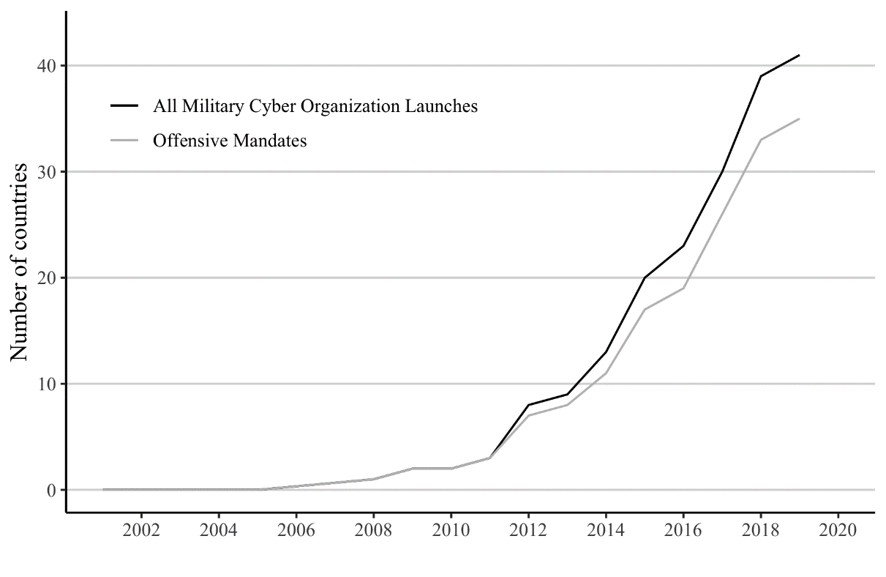
Cyber-Commands
40+ publicly established MCOs
30+ with mandate to conduct ‘effect’ operations
Majority NATO countries now has an MCO

Slide 9
1993
«Cyberwar is Coming»! (Arquilla & Ronfeldt)
1998
Kosovo Conflict
2010
US Cybercommand established
2011
“The 5th domain of warfare”
1991
Gulf War
"The First Information War"
InfOs doctrine (NATO/US)
2018
Persistent Engagement
Offensive cyber-operations:
Use of technological, human, and organizational resources to deny, degrade, disrupt, deceive, or destroy digital services or networks

Slide 10
Council of Foreign Relations “Cyber Operations Tracker” (COT) since 2005 (dataset available for download) https://www.cfr.org/cyber-operations/

Slide 11
Incident Type, 2005-2022
Category added after 2018!
Data: Council of Foreign Relations “Cyber Operations Tracker” (COT)
(dataset available for download) https://www.cfr.org/cyber-operations/

Slide 12
Actors / Profiles
# of identified APTs / country (September 2023) (source: APT Groups and Operations)
China | 126
Iran | 40
Russia | 37
Middle East | 25
North Korea | 10
NATO | 7
Israel | 4
Since 2005, thirty-four countries are suspected of sponsoring cyber operations
China, Russia, Iran, and North Korea sponsored 77 percent of all suspected operations
… What don’t we see? (i.e. which data is not publicly available)

Slide 13
Reaction 3: New Strategy / Identity
Larger Framework Shift to Strategic Competition (intense competition across different domains, including military, economics, and culture)
From Deterrence and Resilience (and “cyber-doom”) to Persistent Engagement
Campaign Mindset
Chinese IP Theft
North Korea’s Crypto Theft
Russian Disinformation
Source: Command Vision for US Cyber Command

Slide 14
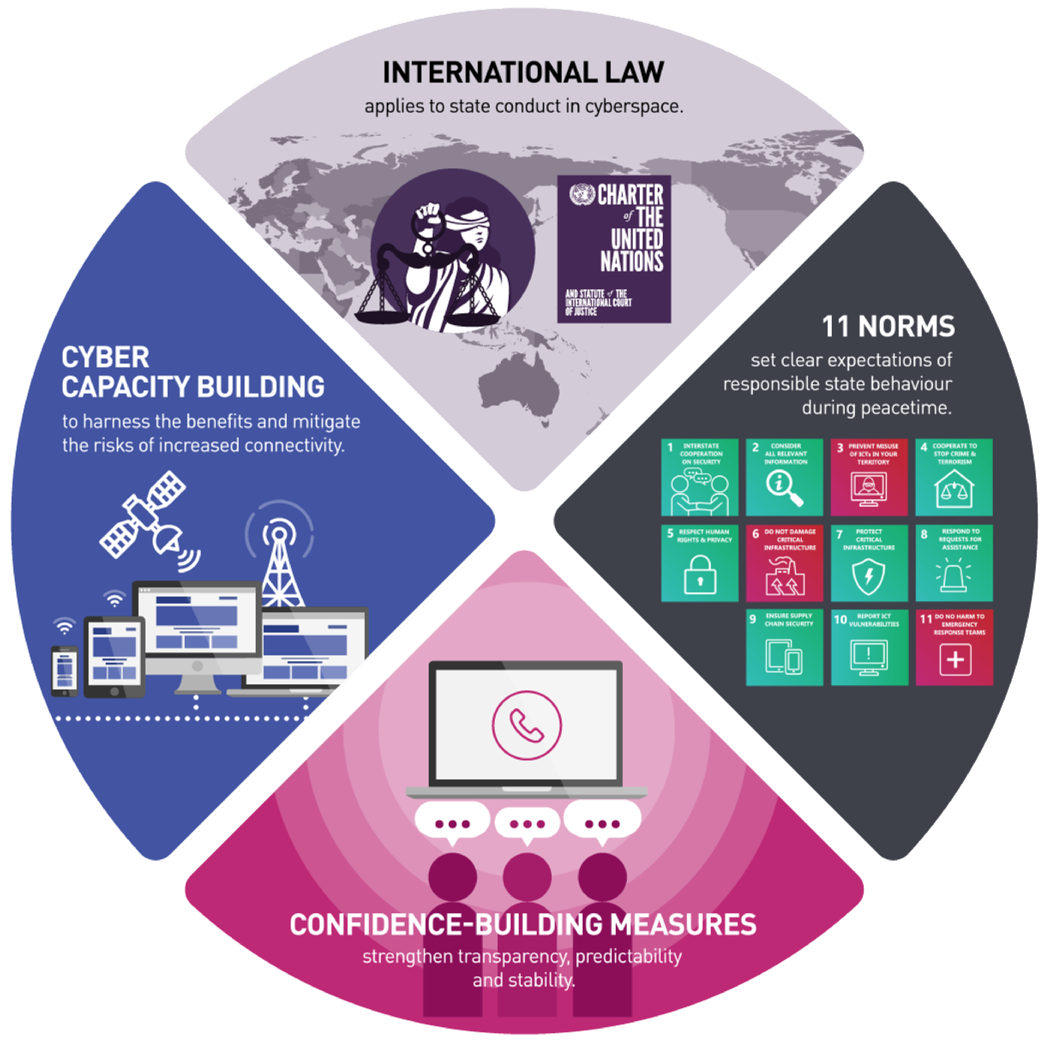
Reaction 4: Norms
High Level Diplomacy | Agreed Competition (direct outcome of “New Strategy”)
The four components of responsible state behaviour in cyberspace | Tacit understanding among key actors “what the legitimate and illegitimate moves are, and what are ‘within the rules’ and what are escalatory moves” (Fischerkeller and Harknett 2019)
 | “Unlike the nuclear realm, where our strategic advantage or power comes from possessing a capability or weapons system, in cyberspace it’s the use of cyber capabilities that is strategically consequential” (Nakasone 2019: 4, my italics)

Slide 15
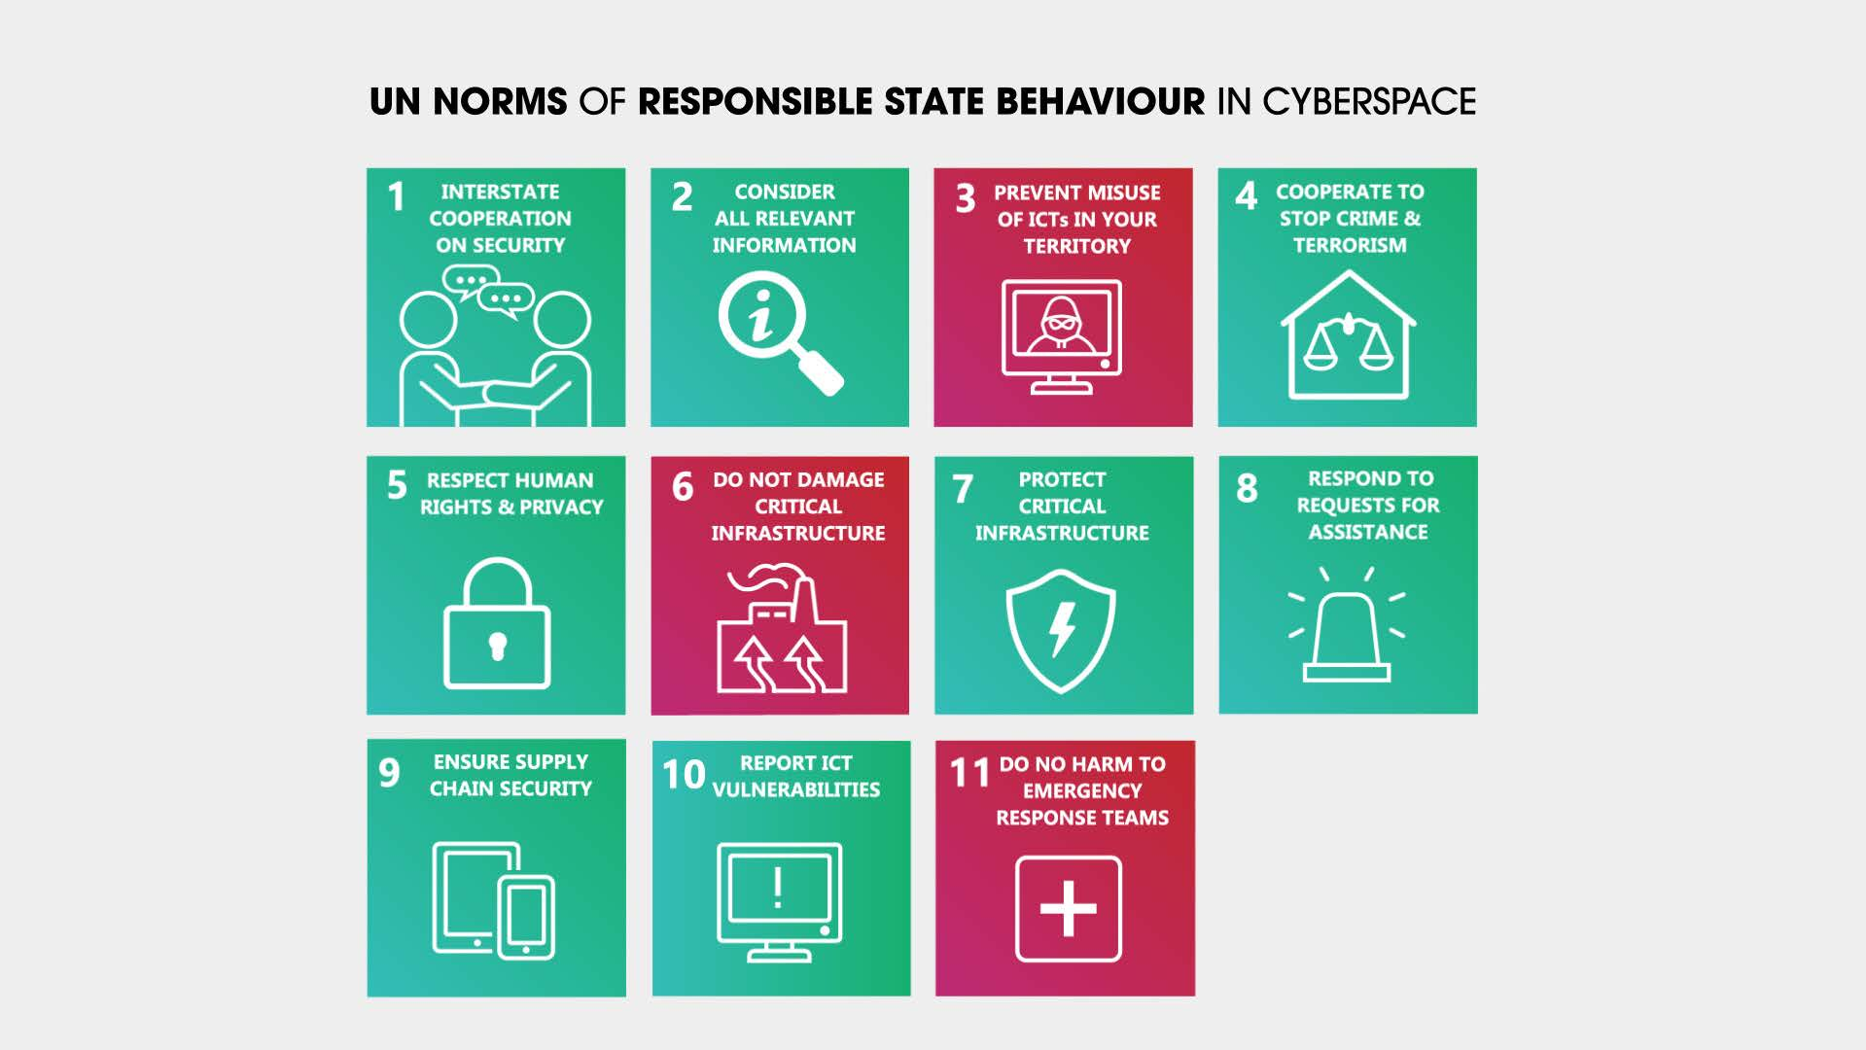

Slide 16
What goes wrong if technological knowledge and political knowledge are not combined?

Slide 17
The “vulnerability”-fallacy: Assumption that because vulnerabilities exist, they will be exploited
The existence of a vulnerability does not tell us anything about why, how, and when it would make sense for an adversary to exploit it and how high the costs are
The “the hack is the success”-fallacy: Talking about the “hack” (network intrusion) as if it were sufficient proof for success
The success of any operation must be determined by the political or strategic effects that are achieved through that operation and how they align with the goals
The “cheap and easy”-fallacy: Assumption that cyber operations are a low-risk “weapon” for the weak
Controlled, targeted attacks suitable to reach strategic goals are not cheap and easy but hard, complicated, and risky
The “just pull the trigger”-fallacy: Belief that cyber tools work like conventional arms
Cyber-operations usually take months if not years to prepare and deliver. They are not something we can simply “launch” at a whim and their use requires planning and integration into chain of commands.

Slide 18
Conclusion & Future Research Avenues
Cyber Security Politics is coming of age (more researchers, more publications, more data), remains highly dynamic (role of incidents)
Needed: Better integration of technical and socio-political knowledge – interdisciplinarity developed in teams
Understand and Explain:
Role of private actors (markets, norms, governance)
How cyber-incidents, public policy and trust / legitimacy interact
From Understanding to Solutions:
How to fix the iceberg problem (have more and better data)
Model and test different governance arrangements
Design processes to strengthen trust that emerges at intersection between technical and national security

Slide 19
Vielen Dank!
Myriam Dunn Cavelty
dunn@sipo.gess.ethz.ch

