Slide 1
Tracking threat actors based on publicly available data
Patrick Schläpfer
Beni Urech
Notes:
Good morning everyone – pleased to be here
Today I present a topic that accompanies me in my spare time since a few years
Tracking threat actors with public data

Slide 2
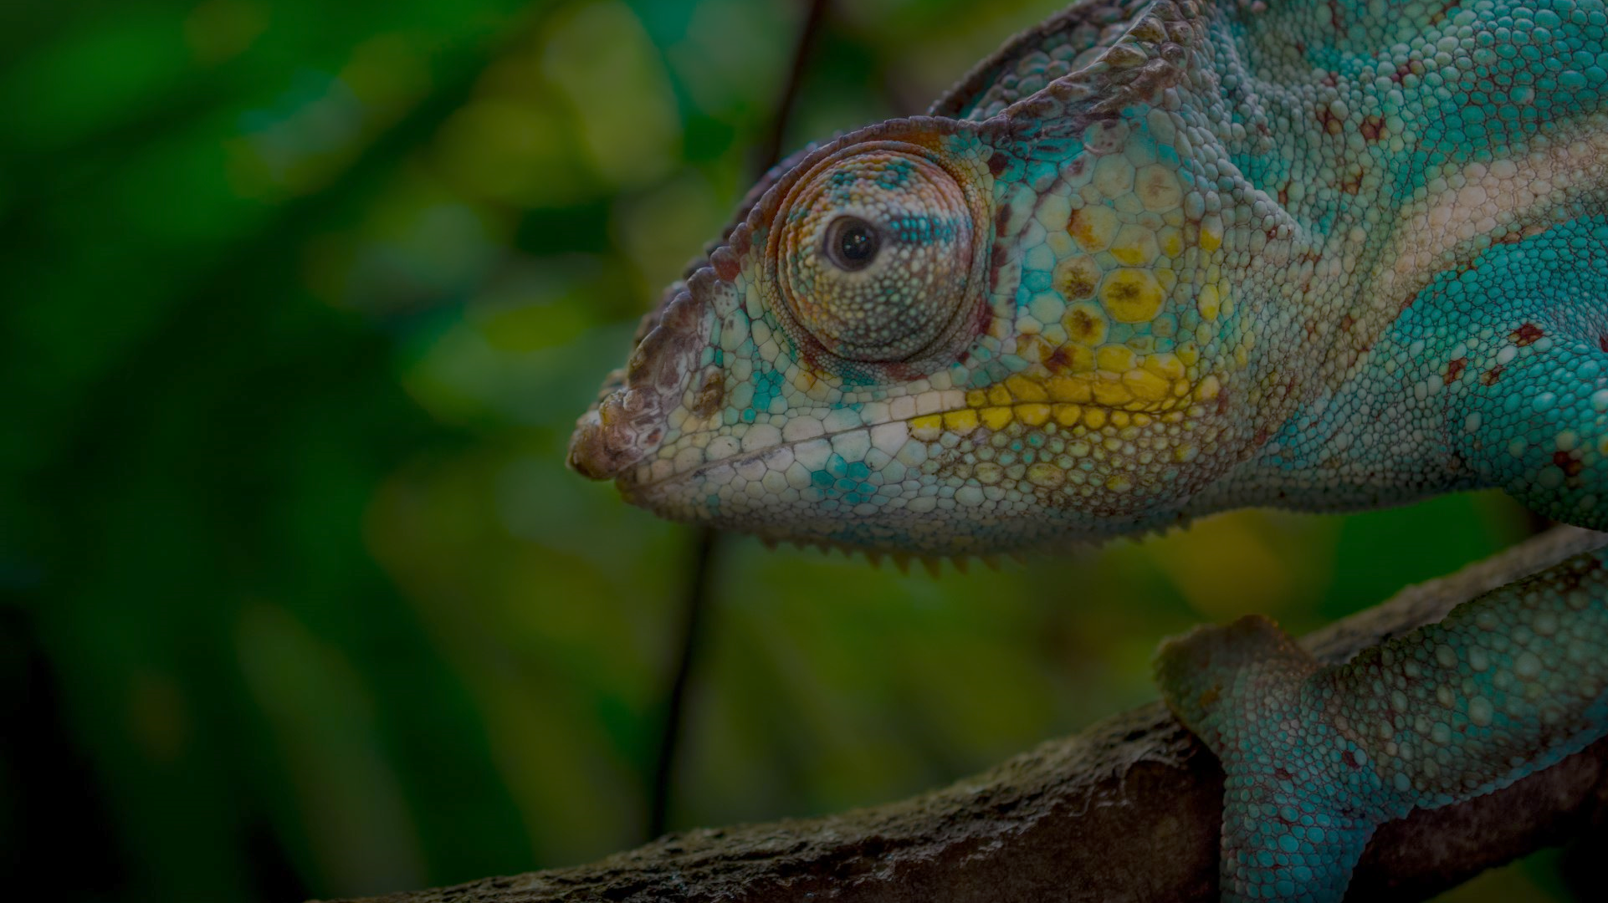
Humans are creatures of habit and routine
Notes:
I'm glad you all made it here today
I know it's still early and I'm sure some of you needed a coffee on the way to the conference
And I'm also pretty sure that some of you grab a coffee once in a while on their way to work
If you do so you I would guess you go to the same store, probably around the same time and order the same type of coffee
But why would you do that? - Well it's just so convenient.
Know the good coffee, know the price, might even know the barista and have a quick chat.
That's part of a routine or habit.
We all have those habits and routines somewhere in our lives.
Like routines when going to bed or getting up in the morning.
Threat actors have habits and routines as well and we can use them to our benefit.

Slide 3
Focus on the Cyber Kill Chain
Notes:
Their habits are reflected in all kinds of tactics and techniques.
In this presentation I would like to focus only on two specific stages.
I'm sure you're all familiar with the Cyber Kill Chain.
Delivery
Command and Control
The reason is that in those stages we have network connections to attacker controlled infrastructure which might allow us to reveal them before the campaign even started.
In the delivery phase the attacker either sends an email with a malicious attachment or malware is distributed web download.
In either case there might be attacker controlled infrastructure such as the mail server or the download server involved.
In the command and control stage the malware connects back to an attacker controlled server which supplies commands and further instructions or payload.
Often attackers register new domains for these infrastructures and that's exactly what we're focusing on today.

Slide 4
A Walk down Memory Lane
sharefiles-download.com
direct-share.com
one-drives.com
Notes:
When I started with this hobby a few years ago a threat actor was active which registered all kinds of interesting domains.
Here are three such domains. And I'm sure you can already see a pattern and find yourself familiar with the words.
They seem to impersonate well known cloud services and all of them contain a dash as well.
Does anyone know which threat actor I'm talking about here?
So there is already a pattern within the domain names itself but are there more pattern based on other available data?

Slide 5
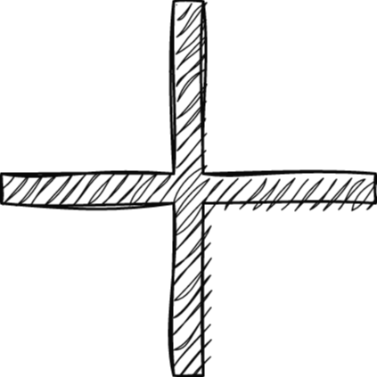
Back in the Good Ol' Days
Eranet International Limited
DNSPod
Let's Encrypt
.com TLD
Notes:
Well yes, there actually are.
This specific threat actor was very static when it came to infrastructure setup.
They usually used Eranet International as their registrar.
They always had dnspod as their dns service provider
All their domains had a let's encrypt certificate.
And they all were .com domains

Slide 6
Wrap-Up after many Campaigns
250+
August 2019
December 2020
Notes:
With this specific pattern the at actor registered more than 250 domains from August 2019 until December 2020.
That's a lot of domains which were used in a lot of campaigns.
What if we could use patterns to detect those domains early and block them even before the campaign even started?

Slide 7
Using Threat Actors' habits of setting up infrastructure to detect it as early as possible

Slide 8
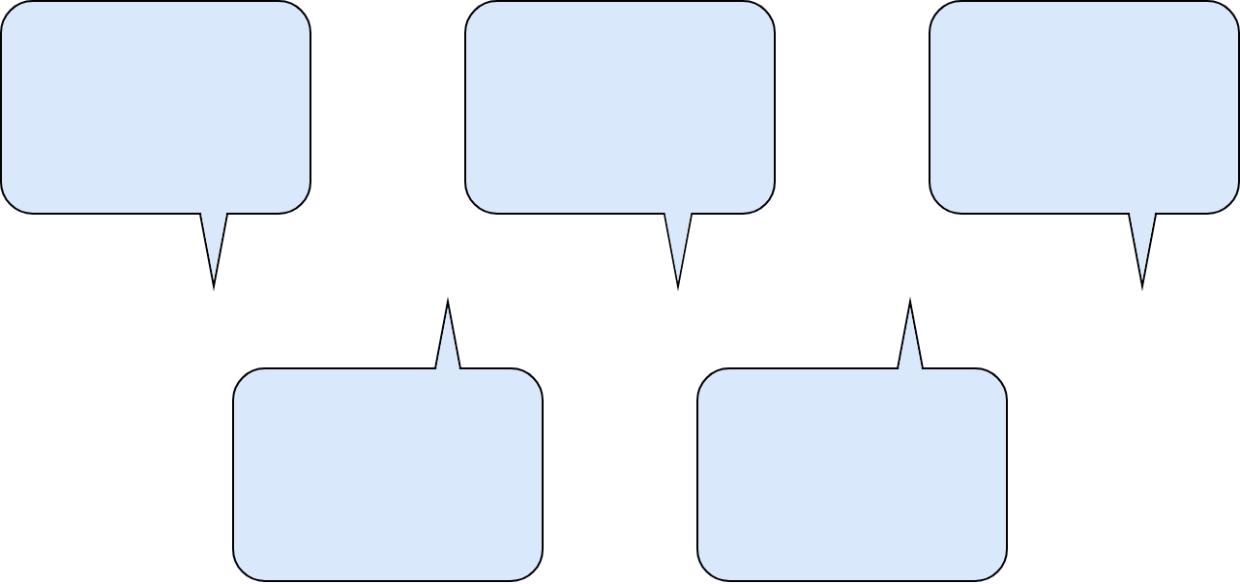
The Disclosure Timeline
Domain Registration
Server Setup
Malware Campaign
Domain pattern
Registrar
Name Server
Hosting provider
JARM fingerprint
Malware sample
Payload domain
C2 domain
Certificate Issuance
Weaponization
Certificate Authority
Certificate Fingerprint
More DNS information
HTTP header / content
HTML meta tags
HTML site title
Notes:
Whenever a threat actor sets up their infrastructure they follow various steps and in every step they disclose some information to the public which we can use
Note that this timeline is not static but certain stages can be interchangeable and executed in a different order.
Let's assume they start with the domain registration. What we get from that is:
Domain pattern itself as we've seen from TA505 earlier
The registrar
And the initially set name servers.
There is also all kinds of other WHOIS information available but in most cases that information is redacted.
If the threat actor decides that they want to use a certificate they will then issue one. Either automatically through the domain registrar or manually.
This gives us even more information:
Certificate Authority
The fingerprint
Potentially more DNS information. For example most domains will have an a record when the certificate is issued.
Now the attacker needs to set up the server where the payload resides or which acts as C2.
At this stage we get more information such as:
The hosting provider
Jarm fingerprint. This is a method created by salesforce which creates a fingerprint which is generated based on the TLS configurations. This can be quite unique for a specific setup. If you for example hunted for cobalt strike C2's I think you know what I'm talking about.
At some point usually right before the campaign the threat actor weaponizes the server to make it ready.
Based on their usage we can now get a lot more information.
HTTP headers and content
HTML information such as meta tags and title
In the end the actual malware campaign is executed. At this stage we get the full picture.
As our idea is to detect their infrastructure before the campaign happens we only use this information now to verify our detections

Slide 9
Sources for our Detections
Certificate Transparency Logs
DNS Zone File
Notes:
Lots of possibilities to detect but where do we get the data from?
As we want to detect them as early as possible we would need to get newly registered domains.
Now you can of course buy such a dataset on a daily basis and then start your analysis from there.
But there are also other options.
The DNS zone files. All generic TLD zone files are required to be published through.
So you can get access to those and are allowed to download them once a day.
In the zone file you get all the domains and their corresponding DNS servers.
If you download them every day and take the diff then you'll get the newly added domains. That's certainly a good start for your analysis.
But as you should only download the zone file once a day you have registrations during the day which might be lost.
Therefore we also use the certificate transparency logs. Every certificate that is issued is published in the certificate transparency logs.
Using those we can extract the common name and therefore get the domain.
Those domains are not necessarily new but some of them certainly are.

Slide 10
Simple as That?
207 Mio. DNS
140 Mio. Certs
147 Mio. Web Requests
4.5 Mio. WHOIS
30 days
Notes:
But is it as simple as that? - Well not really.
A lot of data is involved which makes it a bit more complicated.
Here some numbers to give a rough idea what our systems sees every month.
In a month we get 140 million certificates.
We also get 207 million dns entries. Not records – that would be way more. Basically domains that have at least one record set.
This leads to 4.5 million Whois requests. In this case you can neglect the subdomains and make sure to not redo whois requests which were recently already made.
And a lot of web requests. 147 million of those. Those are combined JARM and HTTP requests.
This amount of data forces us to find good patterns and filter as much as possible.

Slide 11
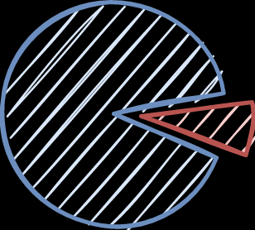
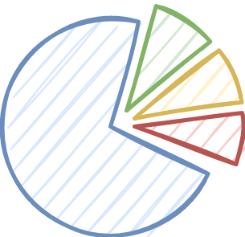
Simple Habits – Simple Detections
Certificate
Registrar
DNS
Geoscaling
1API GmbH
Eailverification
Cloudflare
Cloudflare
No Certificate
Key-Systems GmbH
DNSPod
Notes:
Let's dive into an example.
This threat actor has very simple habits and therefore we'll get a simple detection.
They usually didn't have a certificate
They almost always used Key Systems as their registrar
And used only a few different name servers. For simplification reasons we'll only focus on Dnspod.
Interestingly you can see that whenever they used cloudflare they also got a certificate. Seems like they forgot to untick the box to automatically issue a certificate for their domains.
Now this habit gives us a pattern. Now we want to apply this pattern to our data sources and find the malicious domains.

Slide 12
Remember the Phone Book?
grep by Name Server (dnspod.com)
WHOIS request
(Key-Systems GmbH)
Name Server filtered Domains
Potentially malicious Domains
DNS Zone File
~170
https://czds.icann.org
Notes:
The approach I would chose is looks as follows:
Take the DNS zone file. Here you can also find the link where you can register and download the zone files.
Diff those each day and only have a look at the newly added entries.
As we know they're using dnspod we grep the file and extract all the domains which have a dnspod nameserver set.
At this stage we narrowed it down to around 170 domains per day.
Making this amount of WHOIS requests per day is feasible so we can get the registrar.
If the registrar matches key systems we might have a hit.
Because this combination is not very common the changes that the domain is malicious is pretty high.
If you're uncertain, dump the domains into a slack channel or send you an email or whatever. Check them manually and block them after that.

Slide 13
Detect early – Block early
creekpipes2009b.com
tip-stone2013.com
fossilboring2017z.com
Notes:
Checking them manually works quite well because they also somehow follow a domain name pattern.
You can certainly also write an additional script to include this characteristic to filter even more.
Does anyone know this threat actor or campaign?
TA551

Slide 14
Complex Habits – Complex Detections
WEBCC
Cloudflare DNS
Let’s Encrypt
Inaccurate – Verification needed!
Notes:
Sometimes there are however threat actors with more complex habits
This usually also leads to more complex detections.
Let's have a look at this case.
We have WEBCC as registrar
Cloudflare as DNS
And a Let's Encrypt certificate.
This combination is not accurate enough and therefore we need a verification method.

Slide 15
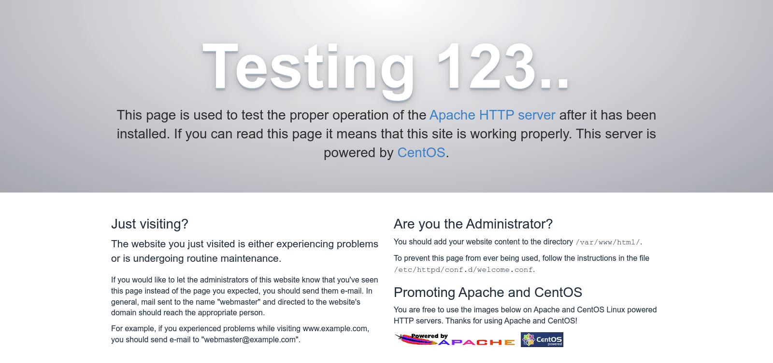
Trust, but verify
29d29d20d29d29d00029d29d29d29decf7fca7fb071cf5a94949fbcc16ef69
JARM
HTTP Content
Notes:
In this case we use the JARM fingerprint and an HTTP request.
As they are setting up they're server consistently we get the same JARM fingerprint for all their servers.
Plus whenever they setup their infrastructure we get a Apache testing page with a non 200 HTTP status code.
Instead of parsing the whole HTTP content we just use the content hash and compare it to the known hash and therefore verify the domain automatically.

Slide 16
Detect early – Block early
euconsalting.com
managmentoria.com
investprides.com
Notes:
And here are some domains which were produced for this specific campaign.
Anyone have an idea what this might be?
Well those were Gozi / Ursnif campaigns which were distributed through the cutwail botnet.

Slide 17
Data Source – Filter - Verify
DNS Information
JARM
DNS Zone File
WHOIS
HTTP
Certificate
HTML
Certificate Transparency Logs
Notes:
Whenever we build such a detection we use this same approach.
We use DNS zone file and the certificate transparency logs as data sources to find new domains.
We then enrich and filter on data such as DNS information, WHOIS and Certificate
And finally to verify we use JARM, HTTP or HTML
Sometimes there are also cases where we use manual verification because creating a generic automation is not as simple.

Slide 18
Is it that easy?
Scale horizontally
Store efficiently
Update continuously
Deduplicate
Notes:
So instead of writing and adapting the pipeline for each use case and each detection you want to do this on scale.
If you do, you have to keep a few things in mind.
Scale horizontally. Especially important for WHOIS requests and all the web requests. Whois has a rate limit and also you'll have performance restrictions when doing millions of HTTP requests.
You also want to deduplicate the domains. For example neglect subdomains and only make whois requests if you haven't already
Store efficiently because you ideally want to search for the patterns and habits of threat actors within your data set
Update continuously. A domain changes, has new DNS records and so on. Update the records but make sure to keep the history.

Slide 19
I know it's early
Threat actors have habits as well
Use the pattern to detect their infrastructure early
Zone files and certificate transparency logs are good initial data sources
Enrich with WHOIS, DNS, HTTP and JARM to verify potential domains
Deduplicate data, scale horizontally and share your findings!
Notes:
I know it's still early for some of you on a Saturday.
So if you slept the whole presentation this is everything in one slide.
Everyone has habits and routines. Threat actors as well.
We use those for our benefit to detect and block their infrastructure as early as possible.
As data source we use zone files and certificate transparency logs. They're free and handy to use
We enrich the data with all kinds of information such as WHOIS, DNS, HTTP, and JARM to filter and verify potential domains
And if you want to do this on scale. Deduplicate the data, scale it horizontally and share your findings. We're very curious what you'll find.

Slide 20
Thank You!
Notes:
Thank you.

Slide 21
Oh, almost forgot those..
base-block.com
files-gate.com
cdn-backdl.com
Notes:
Oh and if you're interested in a very recent detection we wrote. Those domains were just detected over the last couple of months.
Somehow they seem to look quite a bit familiar to TA505. They're used by Turebot.

Slide 22
When can you see what
Domain registration
Domain pattern
Registrar
Certificate issuance
Certificate authority
Server setup
Hosting provider
JARM
Name Server provider
Weaponizing
Content, e.g. HTTP body hash
More DNS information

Slide 23
Back in the Good Ol' Days
DNS
Registrar
PDR Ltd. d/b/a PublicDomainRegistry.com
DNSPod
Eranet International Limited
Internet Invest, Ltd. dba Imena.ua
TLD
Certificate
.com
Let's Encrypt

Slide 24
A Walk down Memory Lane
ms-upgrades[.]com | sharefiles-download[.]com | cdn-box[.]com
att-download[.]com | share-clouds[.]com | onedrives-en-live[.]com
google-eu-cdn[.]com | direct-share[.]com | one-drives[.]com
rapid-stores[.]com | dropboxwcdn[.]com | fast-gl-backups[.]com
dropboxrcdn[.]com | ex-stores[.]com | alpha-telemetry-microsoft[.]com
boxrcdn[.]com | usr-telemetry-microsoft[.]com | direct-upt[.]com
direct-share[.]com | mira-store[.]com | global-downloads[.]com
limo-ones[.]com | fast-bits[.]com | personal-dss[.]com
sl-downloads[.]com | md-downloads[.]com | nffsd-corp[.]com
data-downloads[.]com | ex-downloads[.]com | mgrs-service[.]com
wire-share[.]com | corp-storage[.]com | fasts-downloads[.]com
filessz[.]com | rmt-downloads[.]com | shr-links[.]com
store-downloads[.]com | mslinks-downloads[.]com | corp-downloads[.]com

Slide 25
Threat Actors are Humans too
TA505
ms-upgrades[.]com | sharefiles-download[.]com | cdn-box[.]com
att-download[.]com | share-clouds[.]com | onedrives-en-live[.]com
google-eu-cdn[.]com | direct-share[.]com | one-drives[.]com
TA551
doublelogistics2017b[.]com | harshodonnelld[.]com | hawkinsorangeg[.]com
modeltransport2011b[.]com | hometv1998b[.]com | mixbtc2007b[.]com
credithousehold1998b[.]com | librarycoin2006b[.]com | francopublicg[.]com
CryptBot
lahuwf14[.]top | xjuwdm61[.]top | xjuwir54[.]top
deliverr02[.]top | dseit8pn[.]top | dseven7vt[.]top
dtwelve12pn[.]top | usdeliver168[.]top | dnein9pt[.]top

Slide 26
Threat actors are humans
TrueBot
listofword[.]com | base-block[.]com | lock-base[.]com
files-gate[.]com | leave-note[.]com | nitutdra[.]com
dragonetzone[.]com | midnigthwaall[.]com | romidonionhhgtt[.]com
ChromeLoader
mysitesext[.]com | worldtimesext[.]com | cesprincipledecli[.]com
dogsfanext[.]com | raconianstarvard[.]com | ghtsustachedstimaar[.]com
entxviewsinterf[.]com | disguishedbriting[.]com | gingleagainedame[.]com
Malware through Cutwail
euconsalting[.]com | managmentoria[.]com | investprides[.]com
dokpio[.]com | nibpur[.]com | domanaic[.]com
moreinvesrotial[.]com | inmanagment[.]com | inversinbiz[.]com

